Slide 1

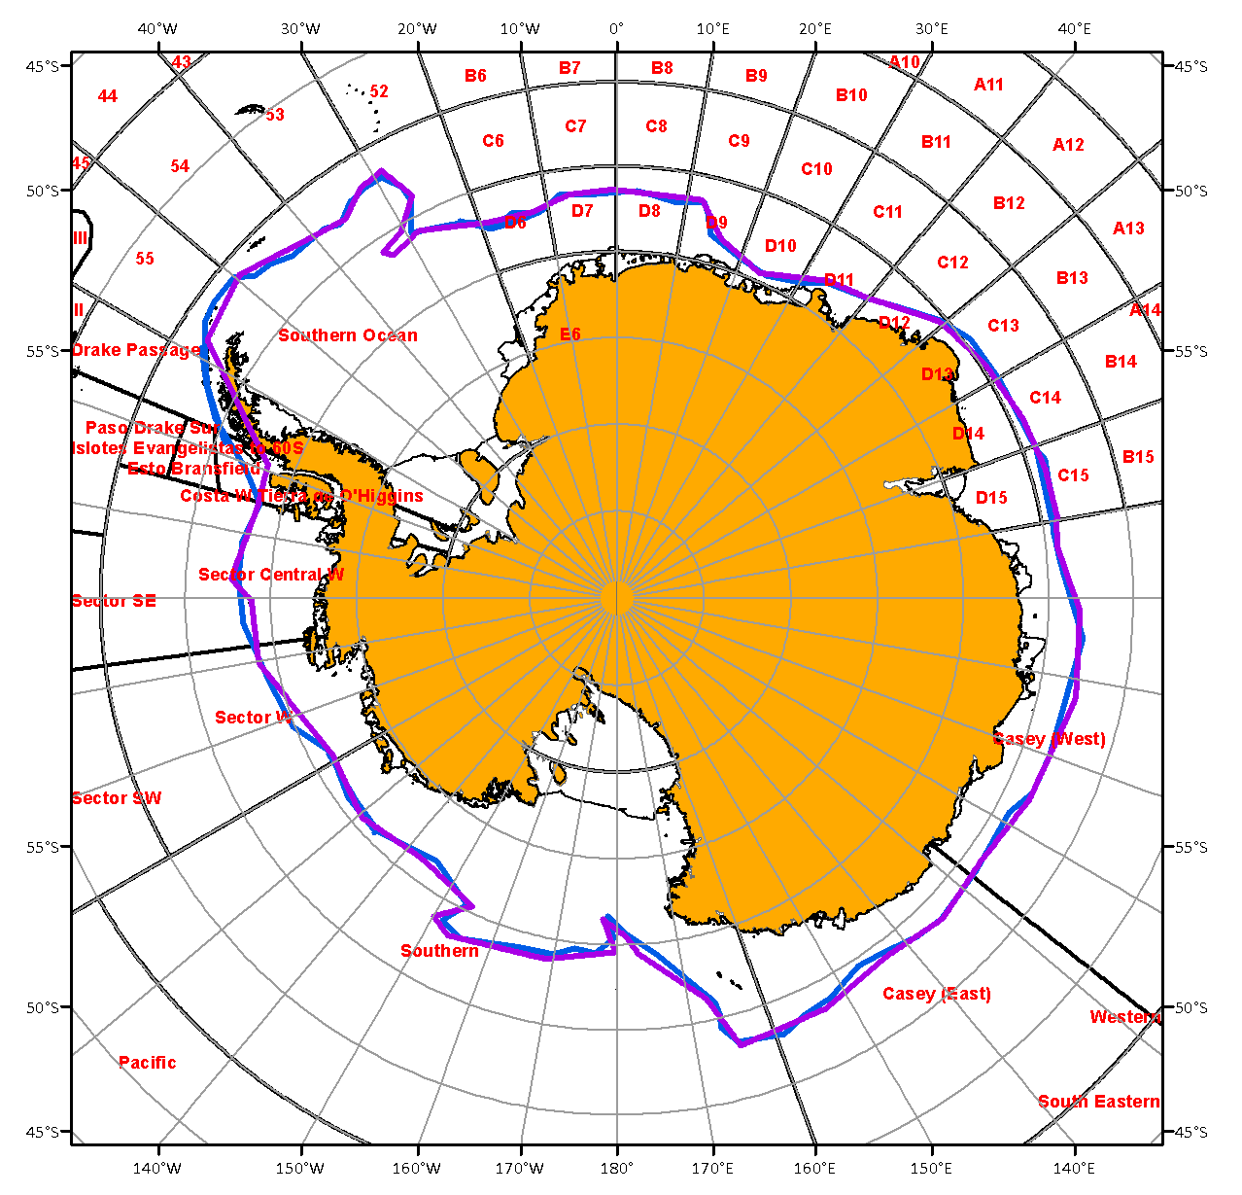
WMO GMDSS status and development for the Antarctic waters: status and briefs from ETSI-V, IAW-4, MSS-2
Vasily Smolyanitsky
JCOMM ETSI chair
IICWG-15, Punta Arenas, Chile, October 20-25, 2014

Slide 2
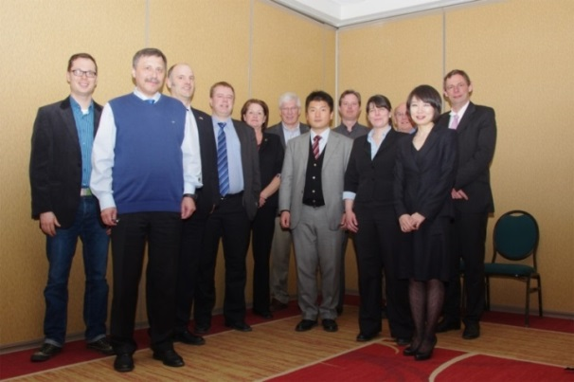
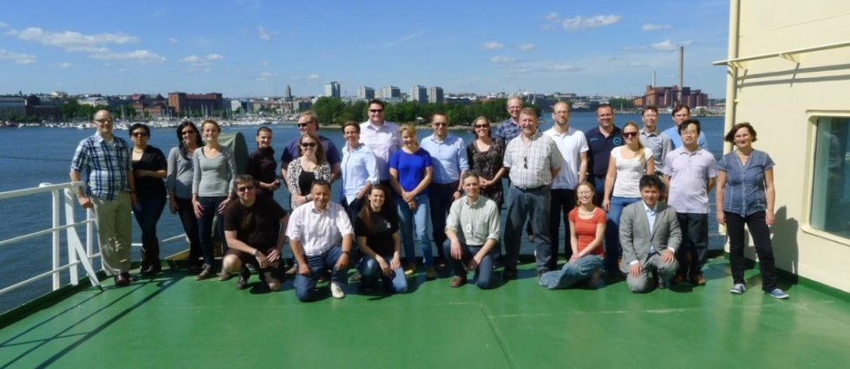
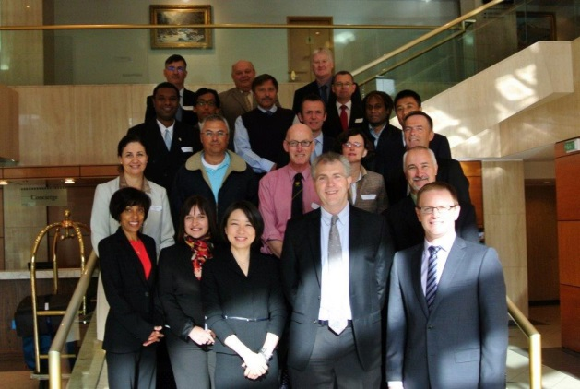
ETSI-V, IAW-4, MSS-2 basics
1) ETSI-V, 25-28 March, 2014, CIS, Ottawa, Canada
3.3 Sea Ice MSI in the sub- and non-Arctic METAREAs and Antarctic
Agree on formal mechanisms to implement [JCOMM] Commission recommendation for the SO METAREAs, to follow the agreement by Arctic METAREAs (XVII to XXI) on exchange and preparation of GMDSS sea ice
2) Antarctic workshop, 12-13 June 2014, as a part of IAW-4
4.4 Extend sea ice GMDSS components for the SO METAREAs
Review regulations for preparation and information exchange for ice in GMDSS bulletins for the SO
Produce ice edge (manual, semi-automatically, automatically) as text SafetyNET and shp-file, post results on a ftp-server, document methods to disseminate information to area coordinators for use.
  3) 2nd MSS Enhancement Workshop, 18-22 Aug 2014, Wellington, NZ
5.2.4 Extension of the ice services for the Southern Ocean
Present ETSI and IAW recommendations to METAREAs coordinators for next actions

Slide 3
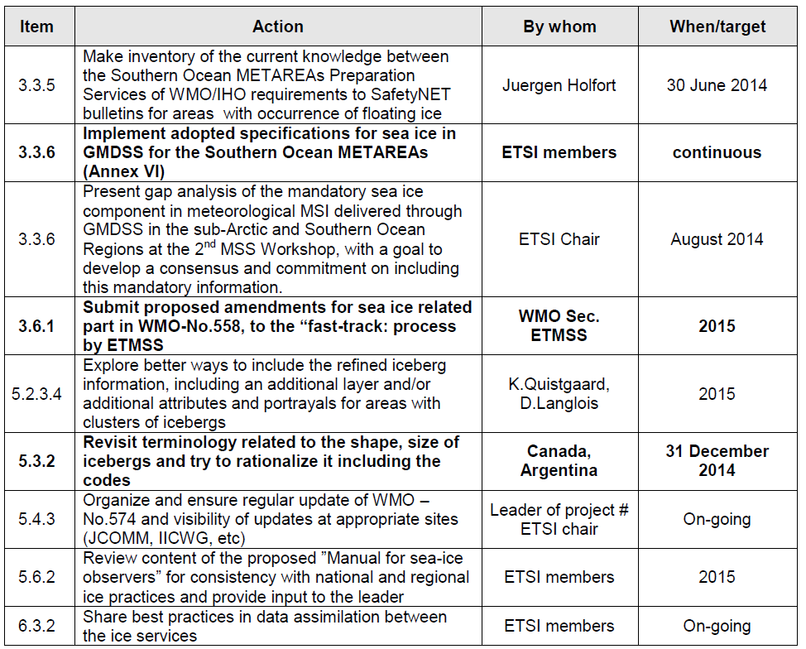
ETSI-V actions:

Slide 4
Antarctic Ice Analysts Workshop

Slide 5
IAW-4 - theme II - Extend sea ice GMDSS components for the SO METAREAs
Case study 2: Produce ice edge for a GMDSS SafetyNET bulletin and document methods to disseminate information
  Review Arctic METAREAS experience and status
  Review regulations for preparation and information exchange for ice in GMDSS bulletins
  Form 2 break-out groups (leads: AARI, NIC, NIS)
  Exchange material and GIS projects (imagery, ArcGIS & QGIS)
  Produce ice edge: manual, semi-automatically, automatically as text SafetyNET and shp-file, post results on a ftp-server
  Plenary presentation of results and comparison
  Plenary summary on specification

Slide 6
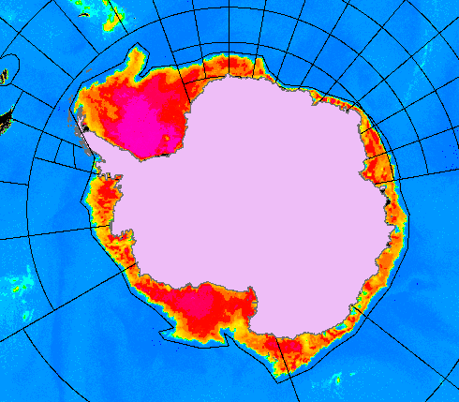
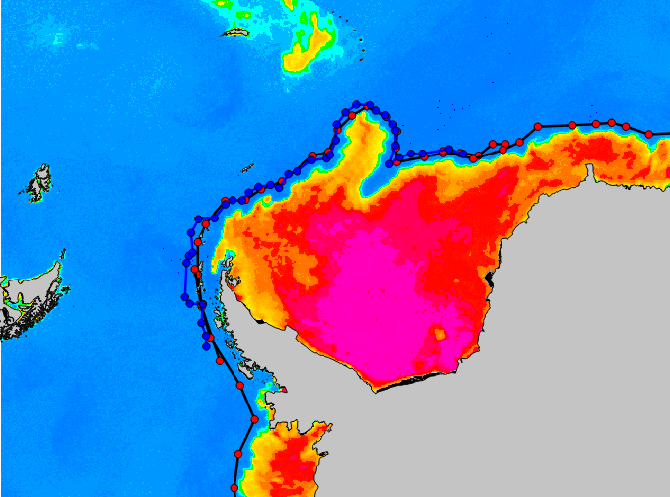
Manual/Automatic based on AMSR2 imagery for 31/03/2014
Group1, AARI & NIC
ArcGIS
Group2, met.no
QGIS
SECURITE
ICE BULLETIN FOR METAREA VI-XV
ISSUED BY AARI AT 1200UTC 13 JUNE 2014
ICE
….
CASEY (WEST)-CASEY (EAST)
ICE N TO 6408S 08000E, 6416S 08338E, 6308S 09134E,
6245S 10210E, 6324S 11604E, 6359S 12600E, 6356S 12800E,
6331S 13430E, 6402S 14319E, 6319S 15259E, 6318S 16000E.
SOUTHERN
ICE S TO 6318S 16000E, 6306S 16428E, 6617S 16724E,
6925S 17627E, 7028S 17823E, 7128S 17733W, 6933S 17949W,
6846S 16854W, 6813S 15325W, 6848S 15003W, 7022S 15454W,
7116S 14311W, 7036S 13035W, 7116S 12000W.
SECTOR W-SECTOR CENTRAL W-COSTA W TIERRA DE O'HIGGINS-
ESTO BRANSFIELD-PASO DRAKE SUR
ICE S TO 7116S 12000W, 7118S 11847W, 6859S 10013W,
6901S 09730W, 6854S 09020W, 6740S 08708W, 6834S 07551W,
6834S 07500W, 6825S 06904W, 6738S 06716W.
NNNN
ICE BULLETIN FOR METAREA 15 ISSUED BY THE CHILEAN NAVY WEATHER SERVICE(gespinosa@directemar.cl) AT 23 UTC 31 MARESTO
SECTOR W
ICE S OF 7004S 11900W, 7152S 11819W, 7010S 11722W, 7027S 11516W, 7031S 11457W, 7059S 11040W, 6909S 10729W, 6927S 10659W, 6924S 10413W, 6933S 10302W, 6951S 10042W, 6951S 09841W, 6804S 09730W
SECTOR CENTRAL W
ICE S OF 6804S 09730W, 6806S 09736W, 6811S 09640W, 6812S 09217W, 6845S 09243W, 6702S 09137W, 6703S 09035W, 6847S 08802W, 6704S 08717W, 6706S 08505W, 6857S 08447W, 6841S 08200W, 6836S 08144W, 6844S 07819W, 6824S 07636W, 6811S 07514W, 6814S 07554W, 6817S 07400WCOSTA W
TIERRA DE O'HIGGINSICE
S OF 6817S 07400W, 6850S 07314W, 6706S 07120W, 6705S 07002W, 6741S 07154W, 6626S 07037W, 6653S 06959W, 6526S 06704W, 6552S 06734W, 6410S 06724W
ICE EDGE NOT FOR NAVIGATIONAL PURPOSES

Slide 7
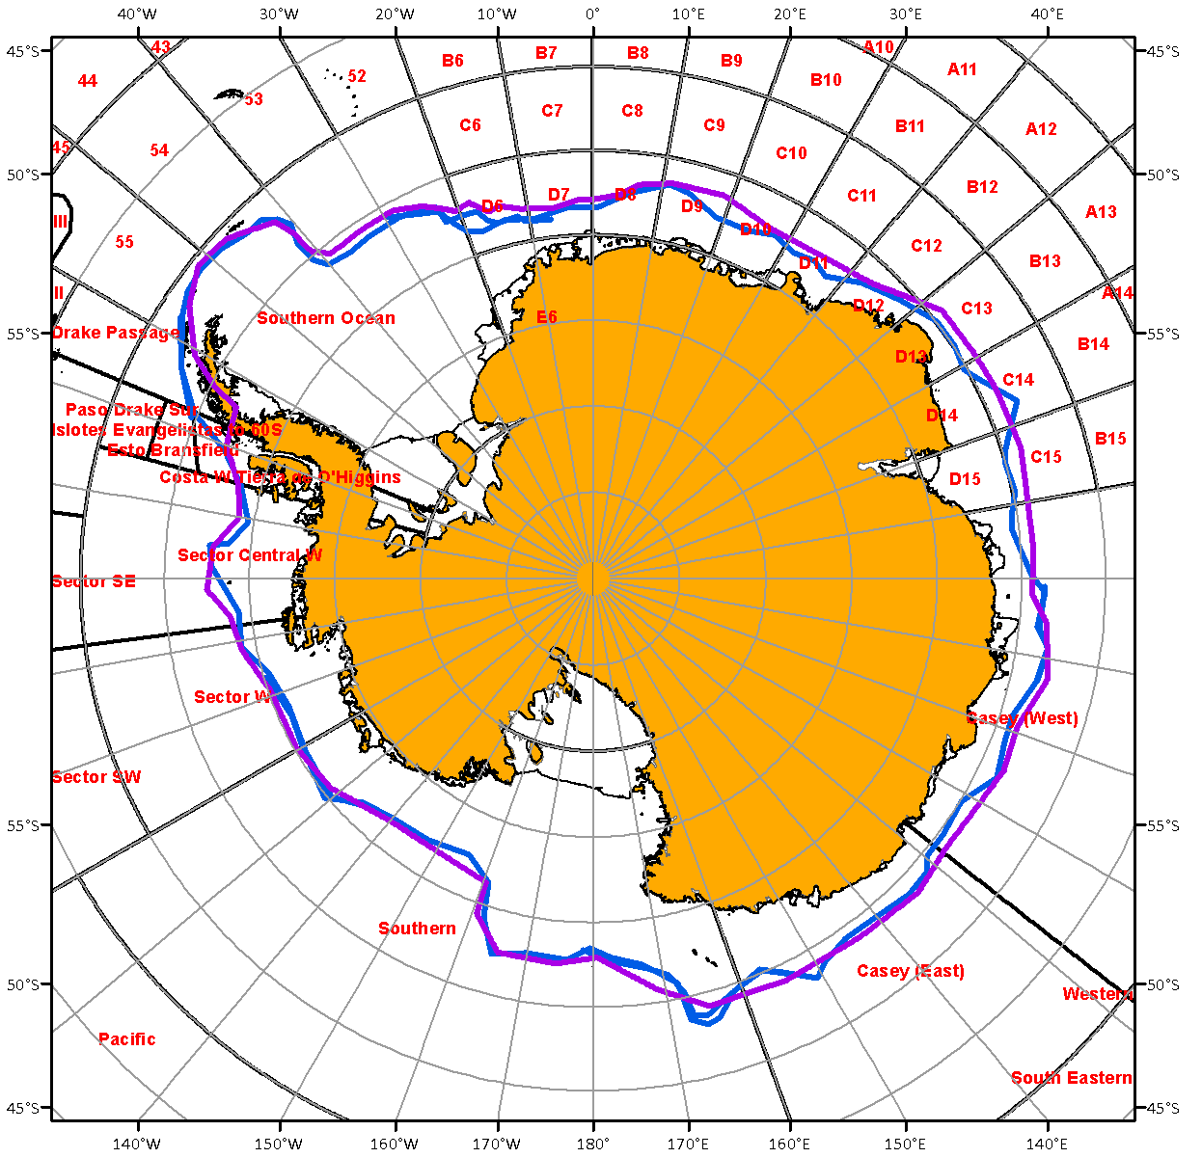
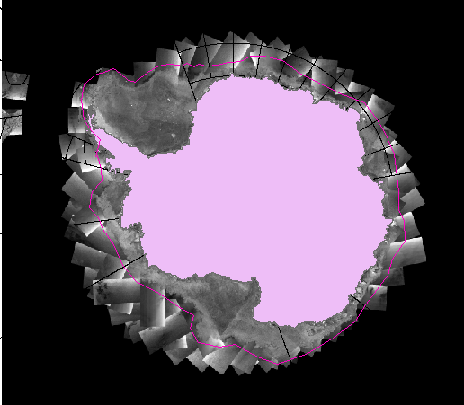
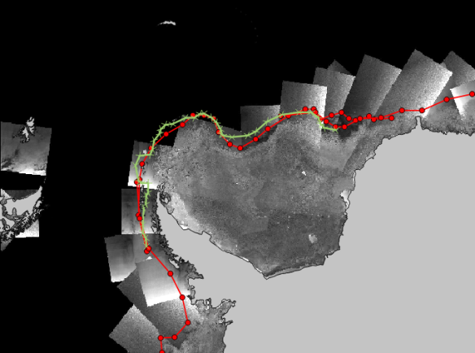
Manual, based on ENVISAT mosaic, for 31/03/2012
Group1, AARI & NIC
ArcGIS
Group2, met.no
QGIS
SECURITE
ICE BULLETIN FOR METAREA VI-XIV
ISSUED BY AARI AT 1200UTC 13 JUNE 2014
ICE
…..
CASEY (WEST)-CASEY (EAST)
ICE S TO 6413S 08000E, 6413S 08551E, 6419S 09205E,
6321S 09537E, 6246S 10226E, 6346S 10917E, 6331S 11457E,
6356S 12059E, 6405S 12726E, 6404S 12800E, 6336S 13402E,
6354S 14327E, 6359S 15422E, 6410S 16000E.
….
NNNN
ICE BULLETIN FOR METAREA 10 ISSUED BY THE BUREAU OF METEOROLOGY TASMANIA(N.Moodie@bom.gov.au) AT 23 UTC 31 MARCASEY (WEST)
......
CASEY (EAST)
ICE S OF 6447S 12759E, 6449S 12836E, 6446S 13027E, 6322S 13227E, 6326S 13457E, 6458S 13747E, 6300S 13932E, 6453S 14024E, 6302S 14136E, 6458S 14355E, 6447S 14528E, 6450S 14742E, 6437S 14902E, 6314S 15205E, 6451S 15401E, 6431S 15442E, 6410S 15628E, 6422S 15729E, 6435S 15959EICE
EDGE NOT FOR NAVIGATIONAL PURPOSES

Slide 8
Recommendations (IAW-4, Ant2/1-6)
1. No significant differences were noted in the ice edge production across the groups
2. Define specifications for clusters of icebergs, iceberg polygons and iceberg targets outside of ice edge for SafetyNET (Action: ETSI)
3. Solve possible ambiguity arising due to possibility of information on the icebergs both in NAVAREA and METAREA SafetyNET bulletins (Action: ETSI, NIC)
4. Add ‘S’ identifier for ice edge (Action: ETSI)
5. Propose the SO METAREA Preparation Services to consider avoiding generic names for METAREA regions and smaller regions to comply with existing specifications for ice parameters, contact the SO METAREAs coordinators to timely provide valid definitions of sub-areas as shape-files (Action: ETSI)
6. Agree that the existing specifications for sea ice in MSI are valid for the Antarctic METAREAs after making modifications stated above

Slide 9
Recommendations (IAW-4, Ant2/7-11)
7. Note great value of automated scripts for creation of SafetyNET content and other conversion procedures for ice analysis products, agree on exchange of developed scripts for testing purposes (Action: AARI, met.no, BSH)
8. Availability of daily imagery not spoiled by weather effects is critical
  Collaborate on availability of radar mosaics from Sentinel & RS2 for the SO, contact Sky-MED for possible collaboration for the safety of navigation in the SO area (Action: PolarView consortium)
9. Manual analysis of the ice edge is a preferred approach, passive microwave may be used for automated creation of SafetyNET ice edge only in case additional weather filters and conservative approach are applied
10. Make survey of existing capabilities among the Preparations Services for production of the sea ice SafetyNET and generic MSI for the ice covered areas of the SO (Action: ETSI)
11. Prepare and present reports for the 2nd METAREA/NAVAREA coordinators workshop in August 2014, NZ, and IICWG-15 in October 2014, Chile (Action: ETSI chair)

Slide 10
Recommendations (MSS-2)
3.0 Sea Ice Met MSI not in certain METAREAS yet. ETSI presented a proposal during the workshop. This proposal needs to be reviewed by ETMSS and then the relevant METAREA Coordinators

Slide 11
Next steps
Agree on ETSI-V recommendations
Review, get consensus and agree on IAW-4 recommendations
Use COMNAP questionnaire as a template and complete a inventory across the SO Preparation Services on a status, gaps and user requirements to MSI and GMDSS components for areas with floating ice occurrence (Action)
Develop a consolidated proposal for JCOMM ETMSS on extending sea-ice GMDSS components in the SO (Action)

