Slide 1


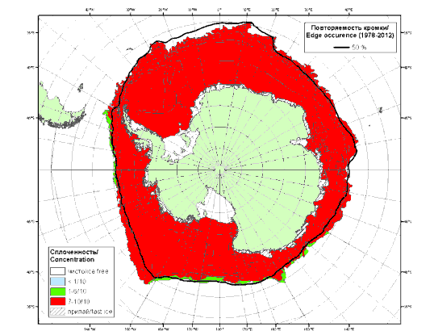
Extension of the ice services for the Southern Ocean - status and briefs from ETSI-V, IAW-4
Caryn Panoviwicz, NIC
Nick Hughes, NIS
Vasily Smolyanitsky, AARI
IICWG-15, Punta Arenas, Chile, October 20-25, 2014

Slide 2
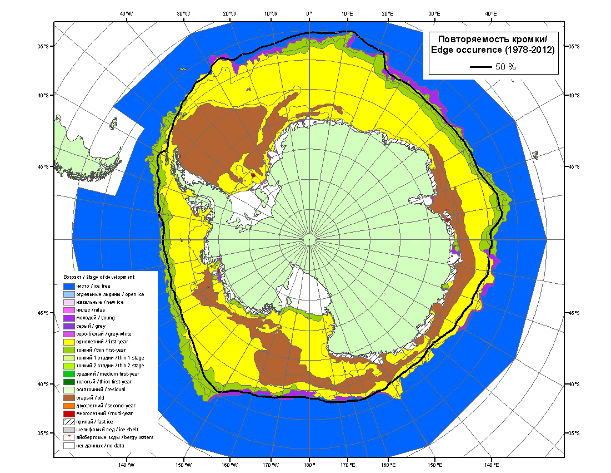
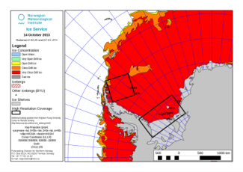
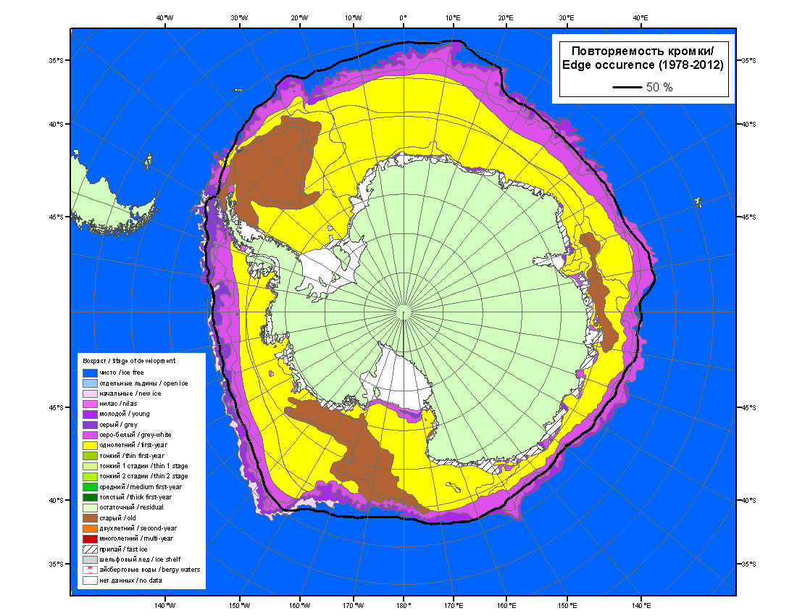
Background (IICWG-14)
Over the years, the ice services have recognized the value of cooperative activities in ice services supporting maritime navigation and polar environmental awareness. With the implementation of the WMO SIGRID3 code used in geodatabases, the possibility of collaborative ice charting has made attaining this goal more realistic.
Currently, AARI produces bi-monthly (1st and 15th) Antarctic Sea Ice Analysis Charts. US NIC produces an analysis biweekly, and NIS analyzes sea ice for the Antarctic Peninsula and Weddell Sea on a weekly basis during the austral summer (October-April). Per agency specific requirements, all three agencies use SIGRID3 to code ice concentration, ice type, ice form, and icebergs.
Because of this overlapping area of responsibility, sea ice services of IICWG would like to implement a regular collaborative method to analyze and disseminate a weekly Antarctic sea ice analysis hence contributing to development of a safer ice navigation in the Antarctic waters as well as regional GMDSS.
NIC ice chart for 2013-09-02
AARI ice chart for 2013-08-31
AARI/NIC ice chart for 2013-08-31/09-02 in ArcGIS environment (colour by CT)

Slide 3
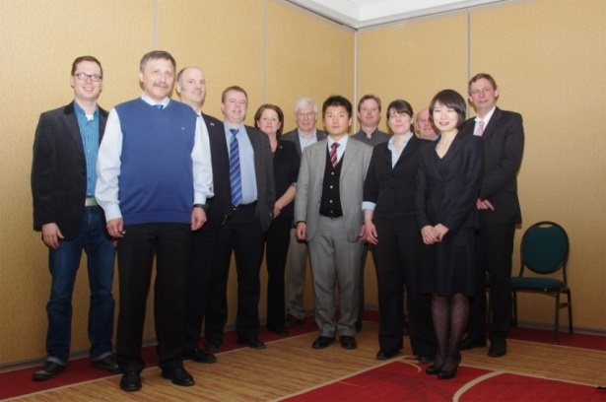
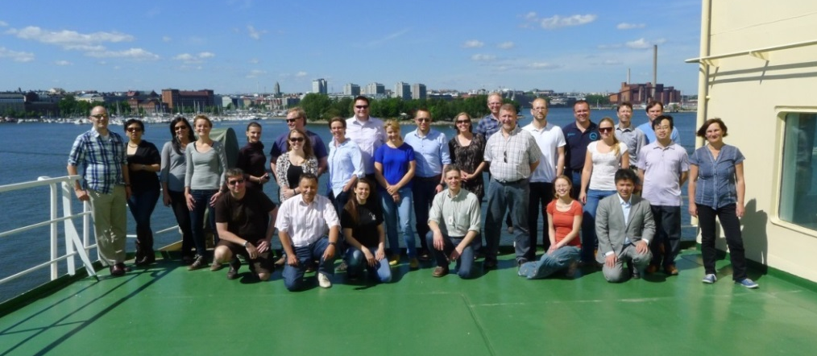
Pre, ETSI-V and IAW-4 basics
December 2013 – February 2014, by correspondence between NIC/NIS/AARI
Develop description for the project “Joint Production of Antarctic Sea Ice Analysis” (background, desired output, requirements) - .DOC
Working paper (What is our main goal, products, coastline / land mask, what imagery, GIS used, logos) - .DOC
Specifications for existing NIC/NIS/AARI products and draft for joint project - .XLS
ETSI-V, 25-28 March, 2014, CIS, Ottawa, Canada
3.3 Sea Ice MSI in the sub- and non-Arctic METAREAs and Antarctic
Review, adopt initial specifications for the Southern Ocean ice analysis – JCOMM MR 114, Annex VI
Antarctic workshop, 12-13 June 2014, as a part of IAW-4
4.3 Develop standard operating practice to jointly produce Antarctic ice analysis and agree on specifications for collaborative product
Run Antarctic summer (Weddell and Amundsen Seas) and autumn analysis (Ross Sea) by 3 groups
Run plenary presentation and discussion
Develop recommendations for JCOMM and IICWG including final specification
JCOMM MR XXX

Slide 4
Antarctic Ice Analysts Workshop

Slide 5
Antarctic Ice Analysts Workshop
Theme I - Joint Production of Antarctic Sea Ice Analysis
Case study 1: Develop standard operating practice to jointly produce Antarctic ice analysis and agree on specifications for collaborative product
  Ice analysis for Antarctic summer (Weddell and Amundsen Seas) by 3 groups
  Ice analysis Antarctic autumn (Ross Sea) analysis by 3 groups
  Plenary presentation of results
  Plenary discussion on specifications for collaborative product and operating practice
  Summary, further steps and recommendations

Slide 6
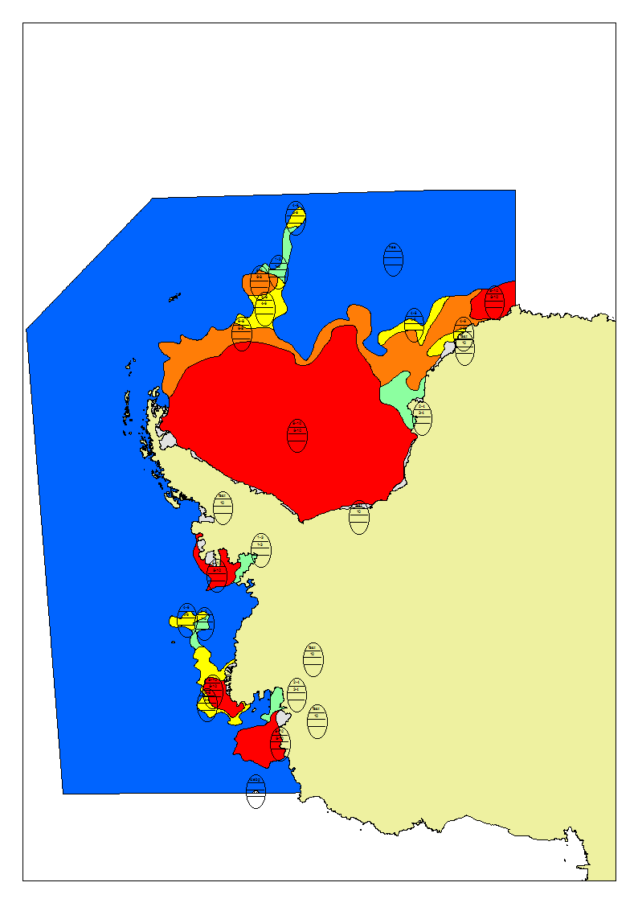
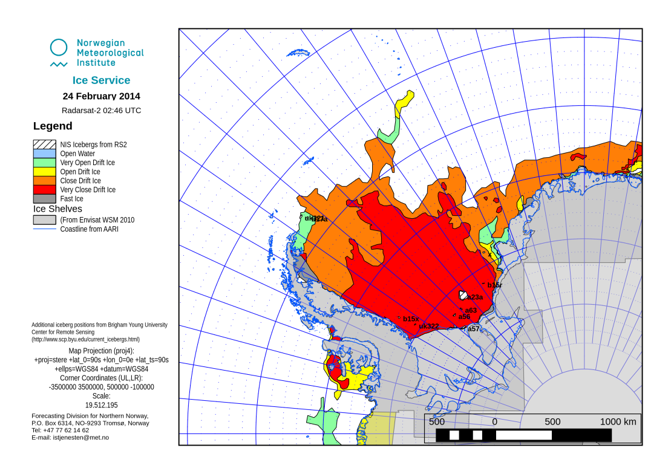
Antarctic summer, CT (Weddell and Amundsen Seas), based on MODIS, ASCAT
Group1, led by AARI
ArcGIS
Group3, led by met.no
QGIS

Slide 7
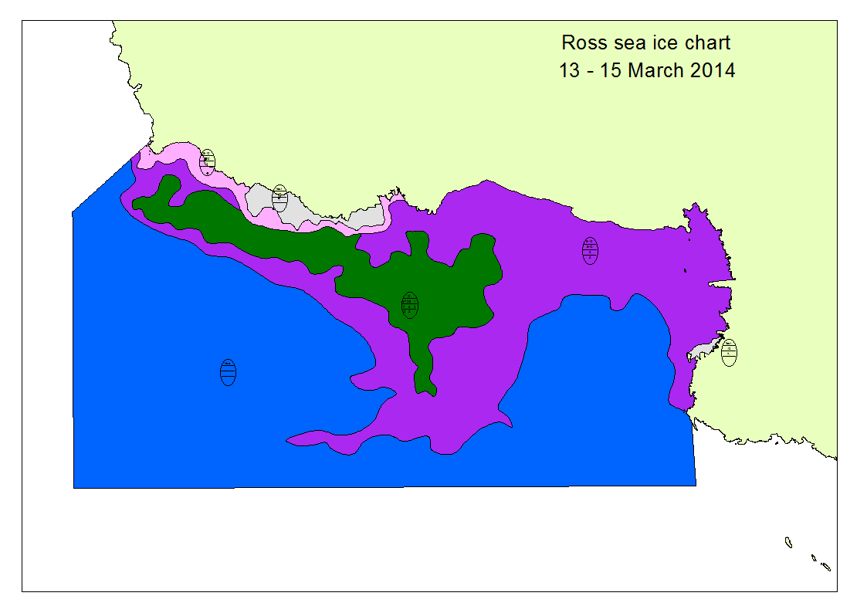
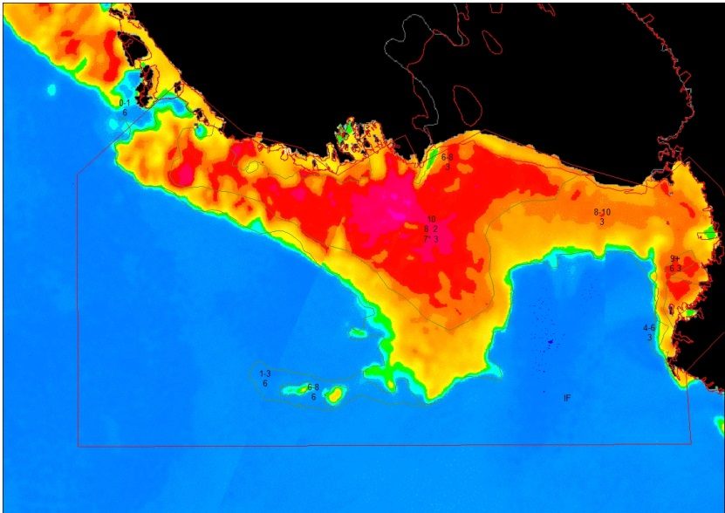
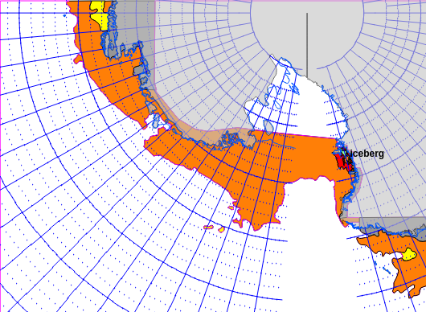
Antarctic autumn, SoD (Ross Sea), based on MODIS, ASCAT, SSMI/I
Group1, led by AARI
ArcGIS
Group2, led by NIC
ArcGIS
Group3, led by met.no
QGIS

Slide 8
Recommendations (Ant1/1-5)
1. Though techniques of ice analysis are different, no significant differences for results exist, both ArcGIS and open-source systems (QGIS) may be used
2. Common database of the imagery is critical and needs to be implemented
3. Template for ice analysts describing special features of the routine collaborative product is necessary and should be created
4. Common single coastline is necessary for the product and should be chosen within the 3 or 4 possible coastlines: AARI, met.no, NIC and SCAR
  Update of the Antarctic coastline is necessary starting with the most significant parts (e.g. McMurdo station, Progress station), partners should be timely informed about the changes, consult/contact Austral Data Center of the Australia Antarctic Division for possible collaboration, make a note that coastline is ‘NOT FOR NAVIGATION’
5. Common layer of icebergs should be present on a collaborative product, with a common database managed by the partners, NIC database with NIC namings is a starting point for complementing by AARI and met.no

Slide 9
Recommendations (Ant1/6-11)
6. Use general ‘old ice’ stage of development with possible further modifications reflecting further motivations from the users
7. Revise CT specifications for a collaborative product with wording that CT values stated by SIGRID-3 should be used; agree on other parts
8. Test input/export capabilities in SIGRID-3/shape-file for GIS ice analysis system prior to start of collaborative production (Action: all)
9. Agree on the following issuing times:
  Thu for AARI/NIC hemispheric odd/even week product
  Mon for met.no weekly Weddell/Amundsen Seas analysis
  odd/even week choice is insignificant but needs to be fixed prior to production
  charts should be available 1 (2-3) days prior to the day of analysis
10. Proceed with exchange procedures, investigate possibility of a single point of access similar to ftp/http gmdss.aari.ru (Action: all)
11. Revise the pilot project WP based on this workshop results (Action: CR)

Slide 10
Specifications for collaborative product
Concentrations | In accordance with SIGRID-3 standard
Ice Types | In accordance with SIGRID-3 standard; expected values at least include: 1 - New ice, 3 - Young ice, 7 - Thin first-year ice, 6 - First-year ice for ice thicker than 7, 7* - Old ice, ^* - Iceberg
Color Code | Based on CT and SoD (varies in season)
Partial concentations | Only for 7*, to continue tracking the amount of old ice, which is the ice type vessels are most interested in.
Eggs/SIGRID | Online content should be available in SIGRID-3 and in graphics with colour coding. Graphic replica with WMO egg-code is desirable but not critical.
Icebergs | Continue to analyze icebergs that exceed 10NM. They're usually not hard to find with MODIS (while daylight), or use previous analysis or our table to help find them. Many are grounded/fasted and do not move. Common layer of icebergs should be present on a collaborative product, with a common database managed by the partners, NIC database with NIC namings is a starting point for complementing by AARI and met.no
Product Dissemination | Analyses to be posted on each organizations websites, as image files and SIGRID-3 in advance of 1 day before the time of analysis for any side. Access to a common set of satellite imagery supporting sustained hemispheric analysis is critical. Partners will investigate possibility of a single point of access similar to ftp/http gmdss.aari.ru
Antarctic Shoreline Update | Common single coastline will be chosen within the 3 or 4 possible coastlines: AARI, met.no, NIC and SCAR. Update of the Antarctic coastline is necessary starting with the most significant parts (e.g. McMurdo station, Progress station), partners should be timely informed about the changes, consult/contact Austral Data Center of the Australia Antarctic Division for possible collaboration, make a note that coastline is ‘NOT FOR NAVIGATION’
Chart valid each week | NIC/AARI charts should come opposite NIS charts in the week so that customers would see two products/week and work would not be duplicated. All charts should not be contradictory, in particular if products are for the -3/+3 days interval. Agree on Thursday for AARI/NIC hemispheric odd/even week product, Monday for met.no weekly Weddell/Amundsen Seas analysis, odd/even week choice is insignificant but needs to be fixed prior to production, charts should be available 1 (2-3) days prior to the day of analysis

Slide 11
Next steps
Endorse activity and agree on approach
Note that technically NIC/NIS/AARI are ready to start by the end of 2014
Actions ?

